Slide 1
An Idea and a Tool
Bharat Bhushan Verma
https://www.linkedin.com/in/dearbharat/

Slide 2
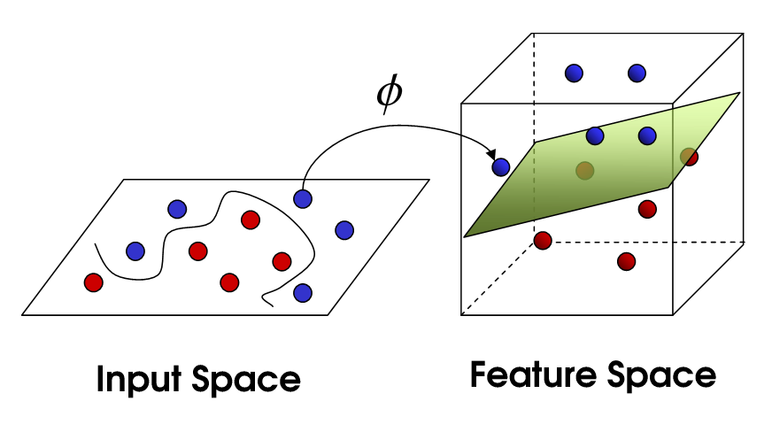
Support Vector Machine

Slide 3

Trello
Trello Templates
Trello Examples
https://www.slideshare.net/AnneUy3/easy-how-to-use-trello-tutorial-for-beginners
https://trello.com/b/6uEFAqPW/trello-for-academics-and-instructors
https://medium.com/keep-productive/how-to-use-trello-as-a-student-df7b2ec2c451

